Slide 1
Indian Liver Patients
BY
Ashwin
Prasad
Shintu Mathew
Sreelalan S
Swaroop Murali

Slide 2
Indian Liver Patients
Aim of this research is to develop a model for early detection of liver disorder from imbalance Liver Function Test
The initial stage symptoms of the diseases are vague so the medical practitioners often fail to detect the disease. The model tries to improve the accuracy using various classification algorithms.

Slide 3
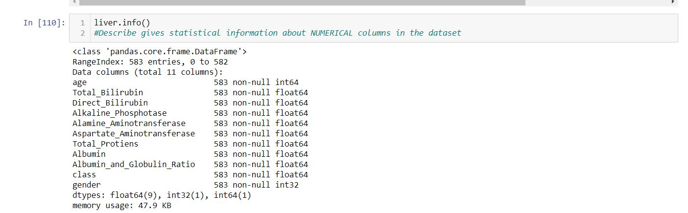
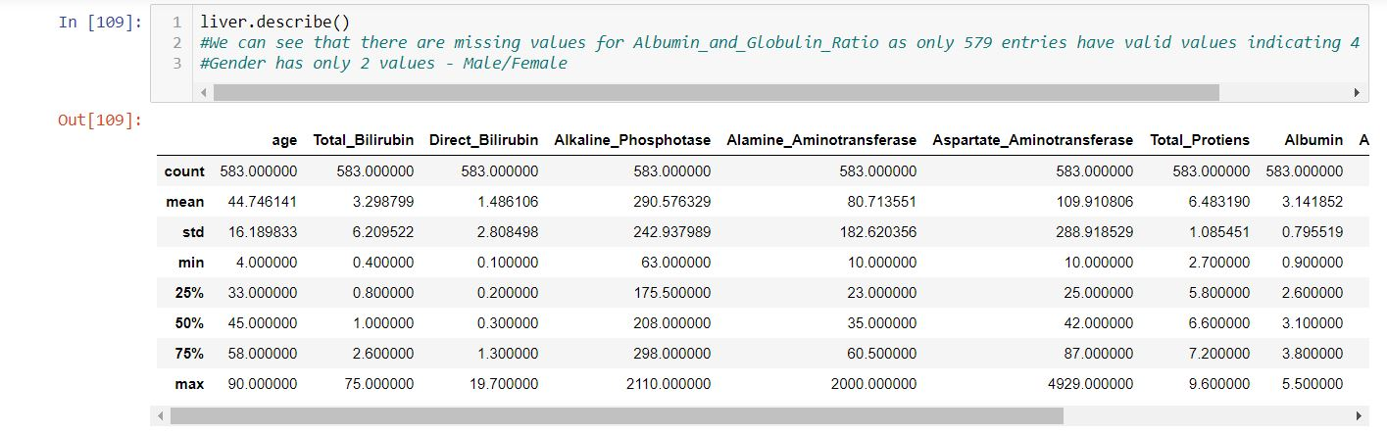
EDA – Visualization of the data

Slide 4
Explanation of each feature
Bilirubin is a substance made when body breaks down old red blood cells. Bilirubin is also part of bile, which liver makes to help digest the food.
Alkaline phosphatase, or ALP, Aspartate transaminase, or AST and Alanine transaminase, or ALT are the enzymes which are found in the blood. They are present in higher quantity when the liver is damaged. They are leaked into the blood.
Total protein, is a biochemical test for measuring the total amount of protein in the blood.
Albumin is a protein made by the liver. Albumin helps keep fluid in the bloodstream so it doesn't leak into other tissues.
Globulin. This is a group of proteins. Some of them are made by the liver. Others are made by immune system. They help fight infection and transport nutrients.

Slide 5
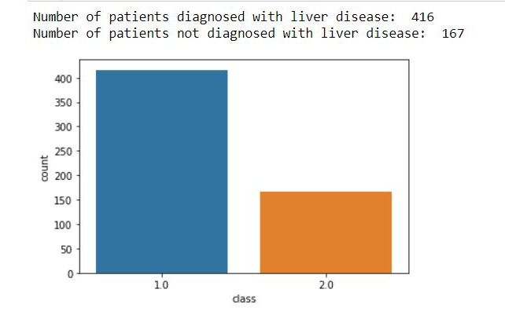
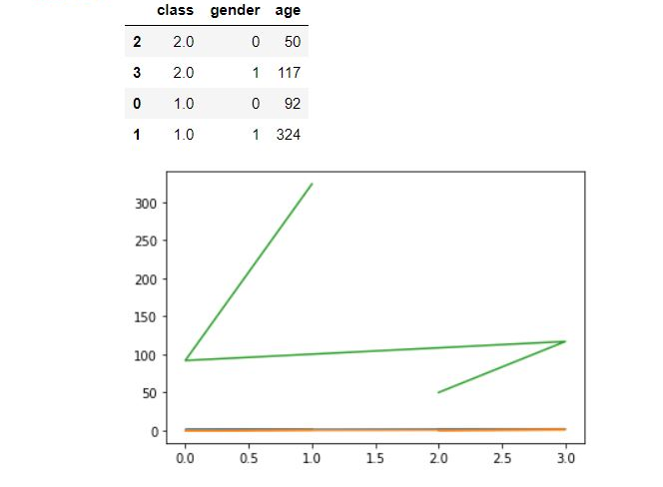
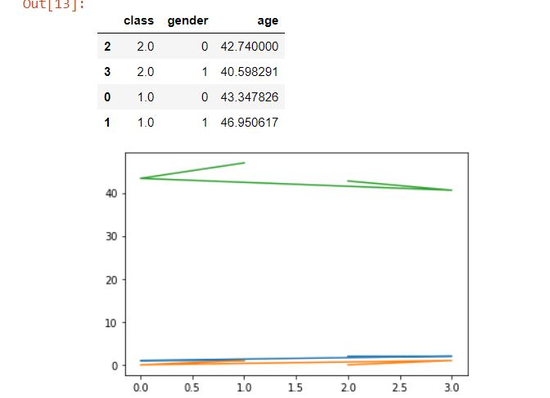
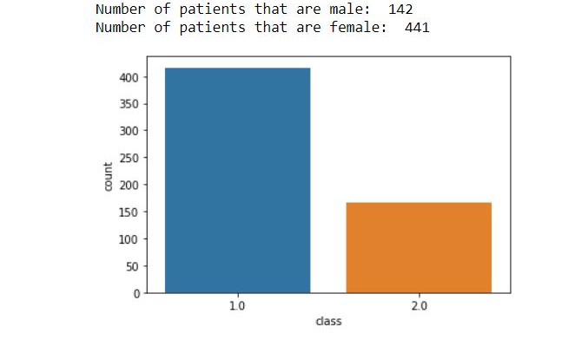

Slide 6
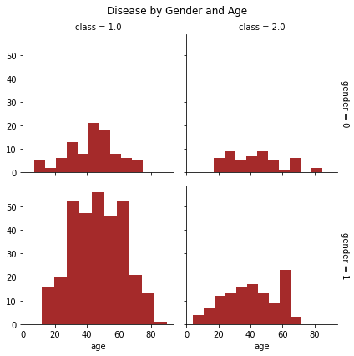
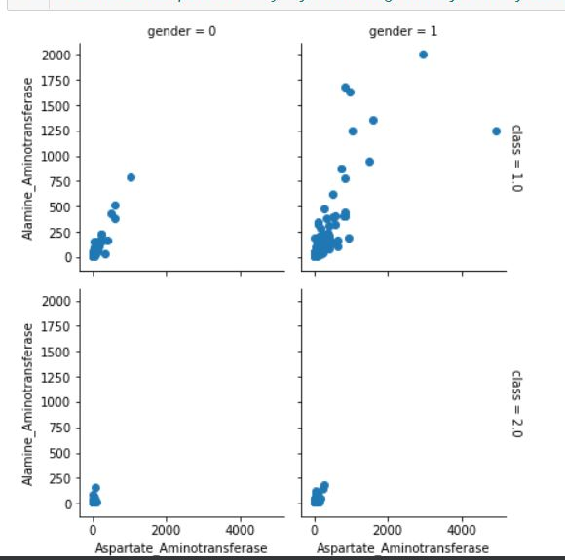
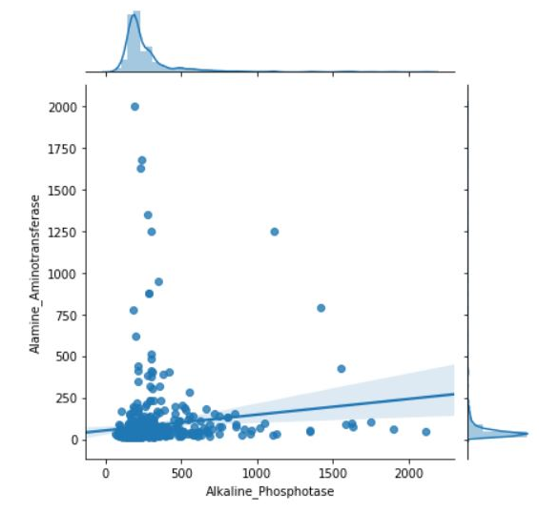

Slide 7
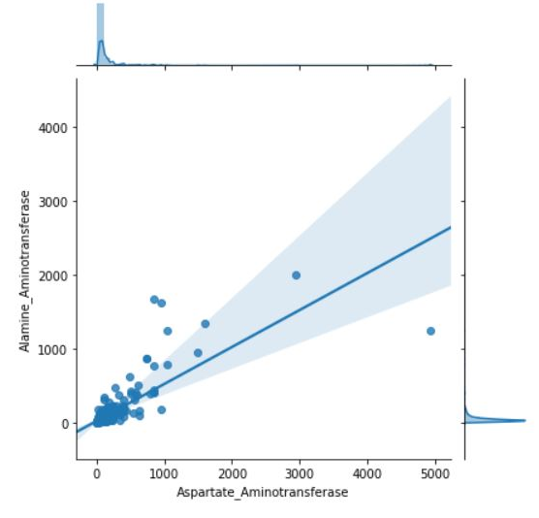
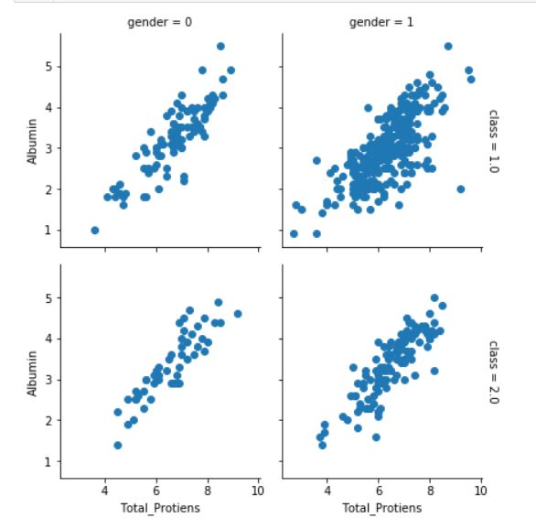
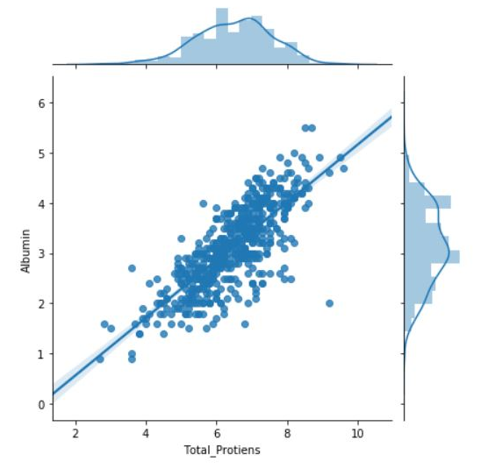

Slide 8
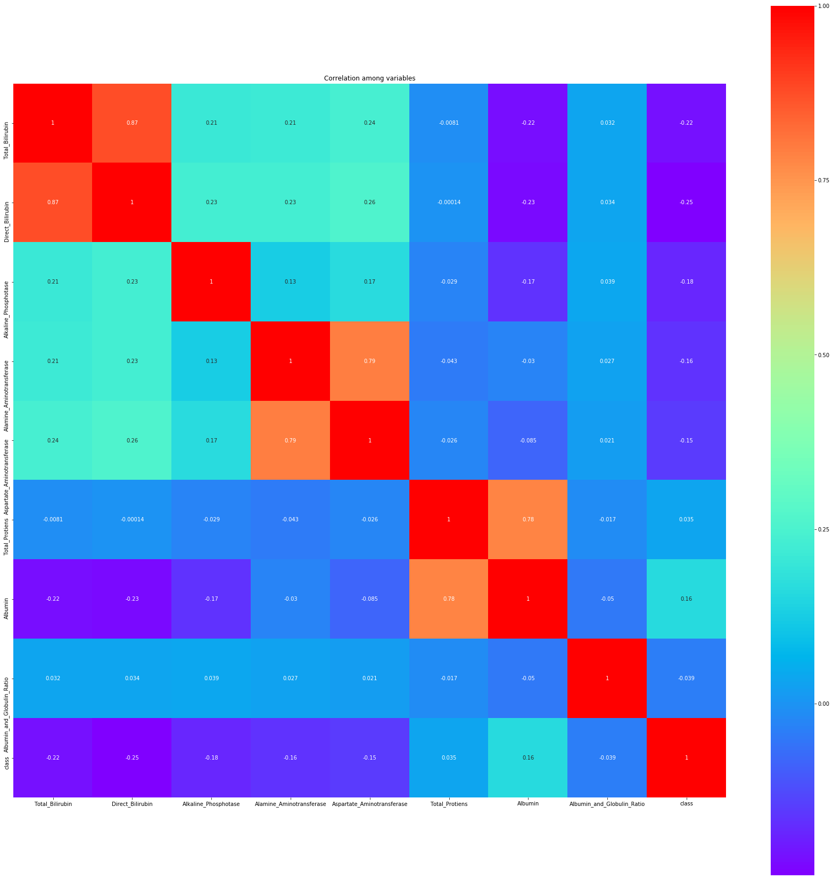

Slide 9
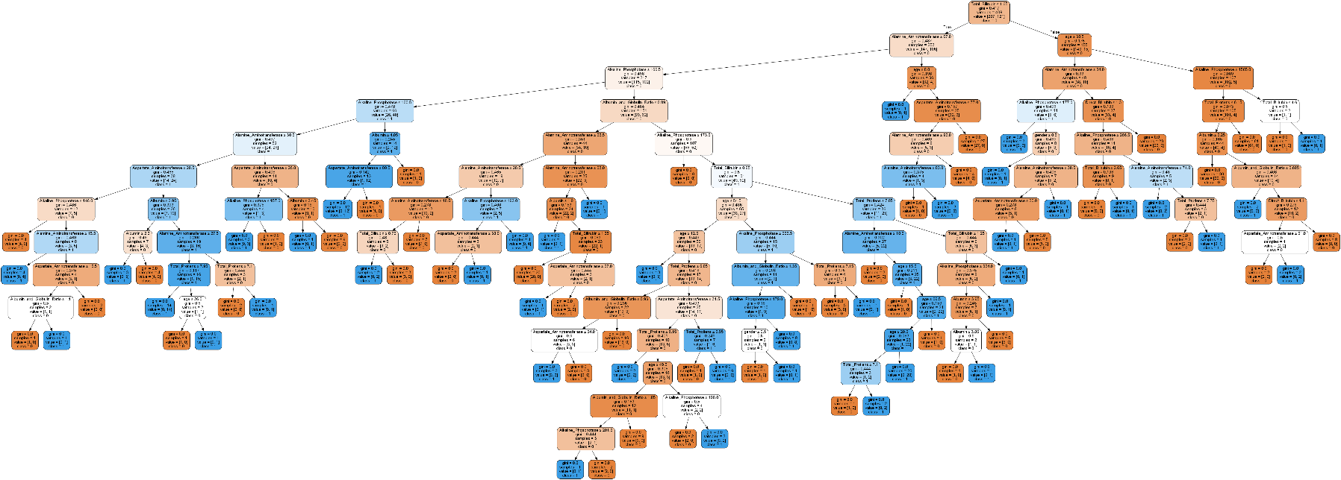
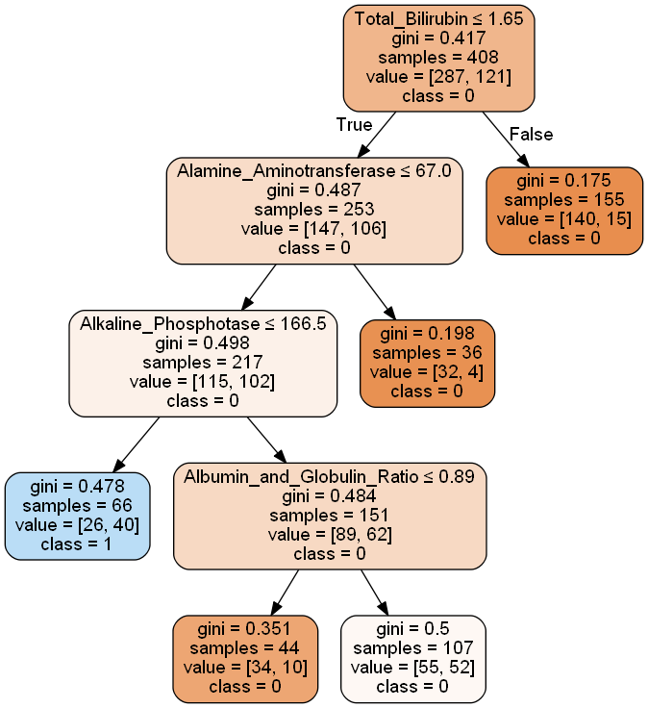

Slide 10
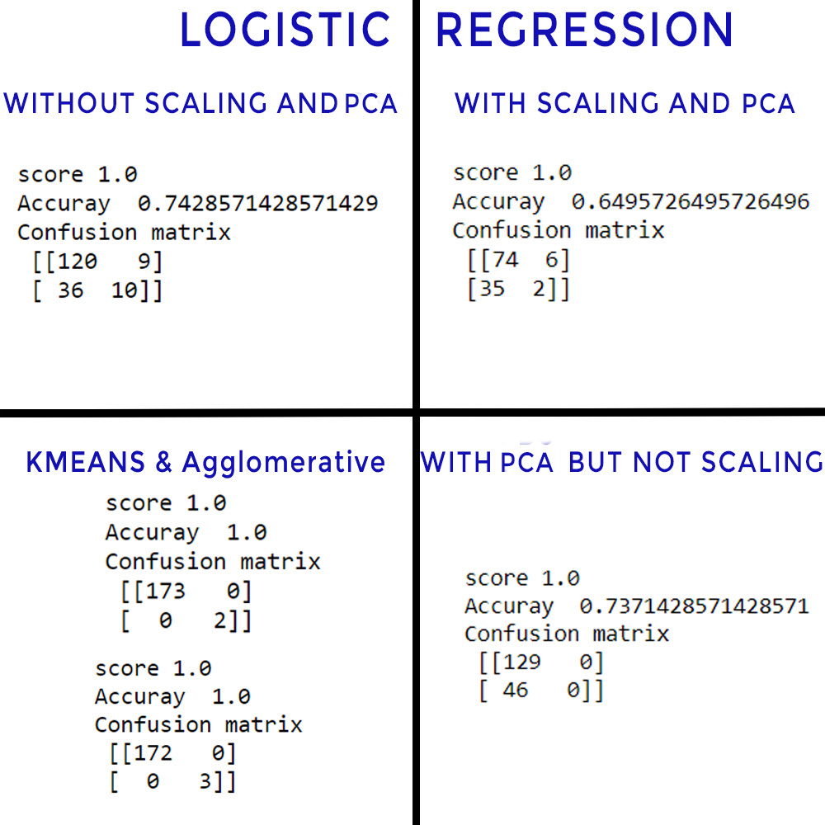

Slide 11
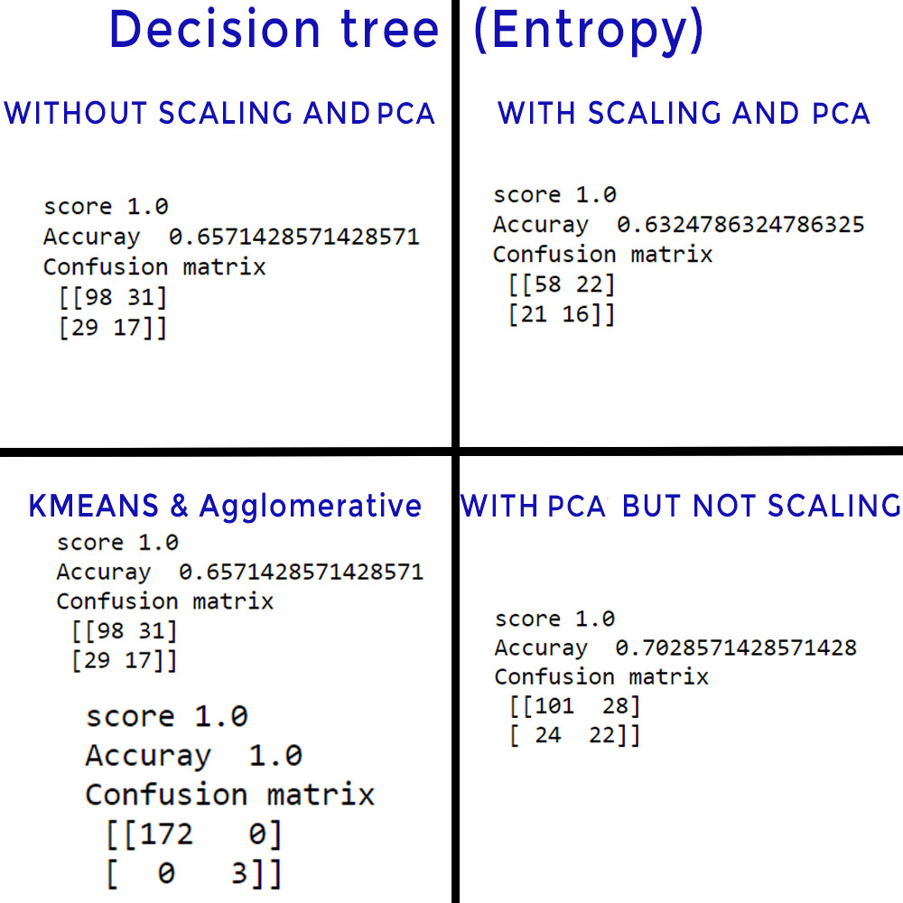

Slide 12
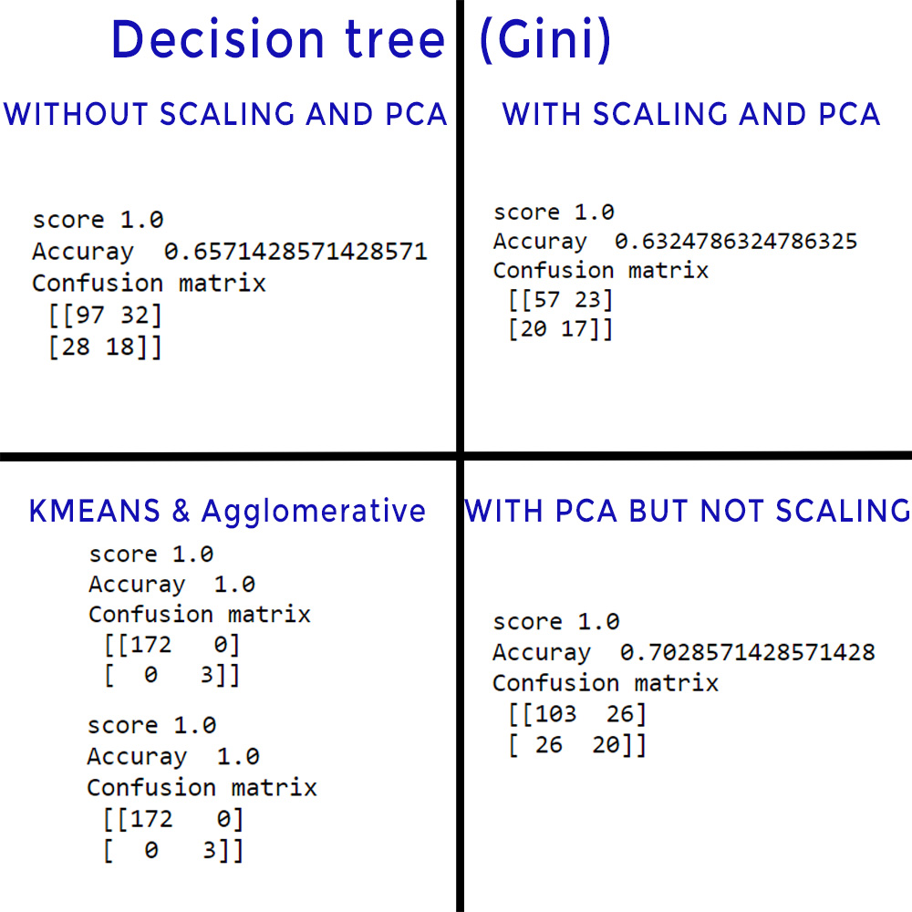

Slide 13
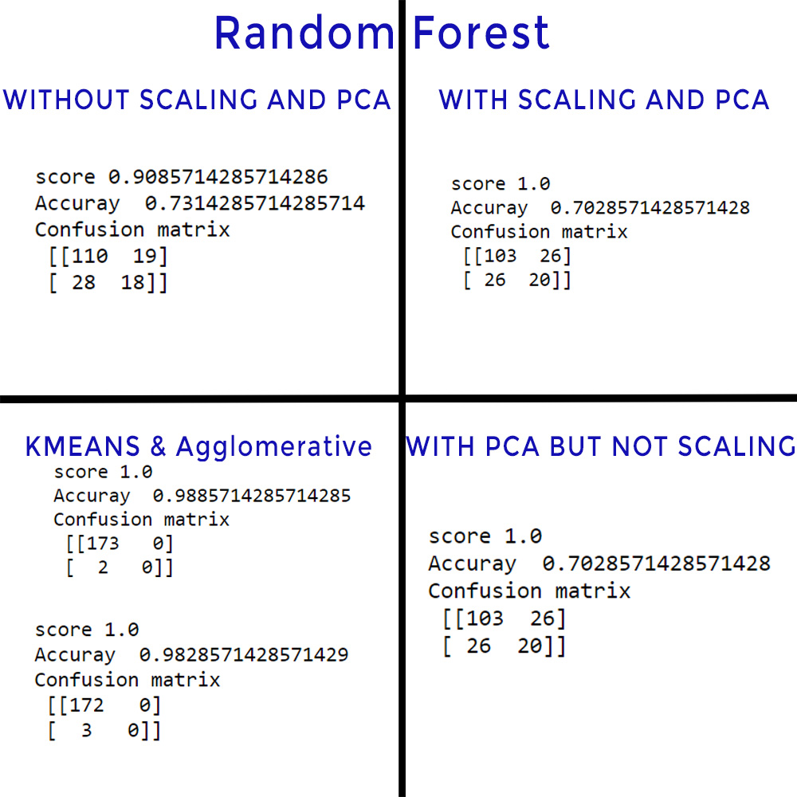

Slide 14
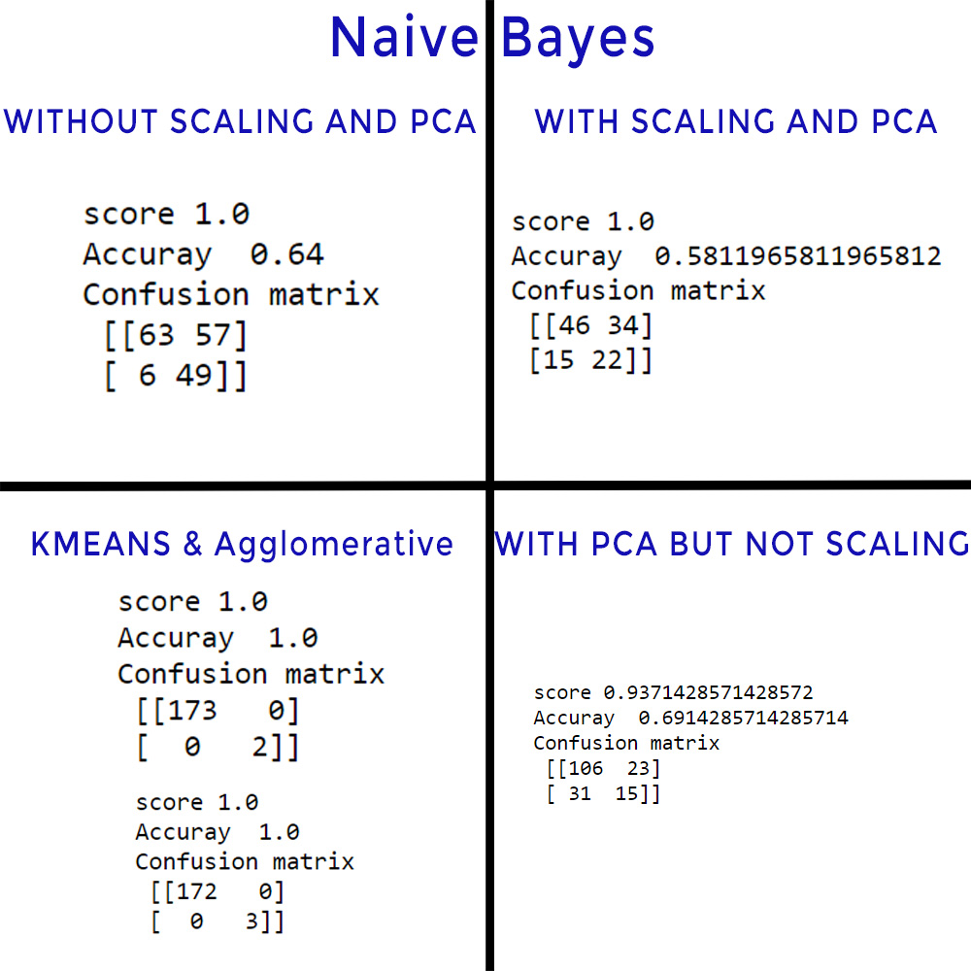

Slide 15
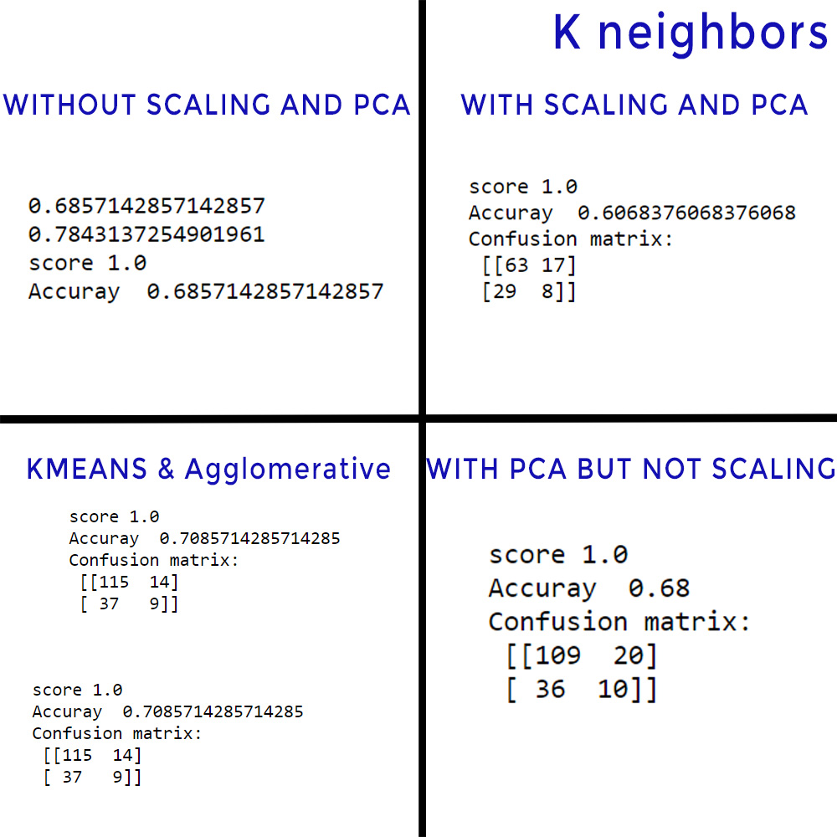

Slide 16
Inference
logistic regression accuracy is highest without scaling and PCA - 0.74285
Decision tree (entropy)accuracy is highest without scaling but with PCA -0.70285
Decision tree (gini)accuracy is highest without scaling but with PCA -0.70285
Random forest accuracy is highest without scaling and PCA - 0.731
Naive Bayes accuracy is highest without scaling but with PCA -0.6914
K Neighbours accuracy is highest without scaling but with PCA -0.68
Overall, for this dataset, Logistic regression yields better accuracy with 0.74285

